Slide 1

Microsoft Fabric
Integrated Analytics Solutions in the Age of AI
Notes:
Introduce the Microsoft team to the customer

Slide 2


Data Activator

Slide 3






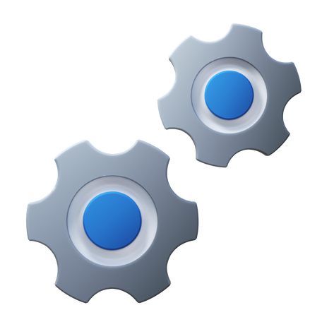

Introducing Data Activator
OneLake
Teams
Outlook
Power BI
Data Activator
Synapse Data Warehouse
No-code user experiences
Power Automate
Synapse Real Time Analytics
Custom
Models
Rules
Triggers
…
Real-time stream processing
…
Notes:
Reflex is a system of detection.
It lets your business’s subject-matter experts monitor all of your data in the Microsoft Cloud.
They can use the easy, familiar experiences of Fabric to model that data, define the changing conditions in the data they want to look for
They set up real-time triggers that act on insights.
And Reflex sends notifications, kicks off workflows, or even reaches directly into operational systems to optimize how the business runs

Slide 4
Demo: Data Activator

Slide 5
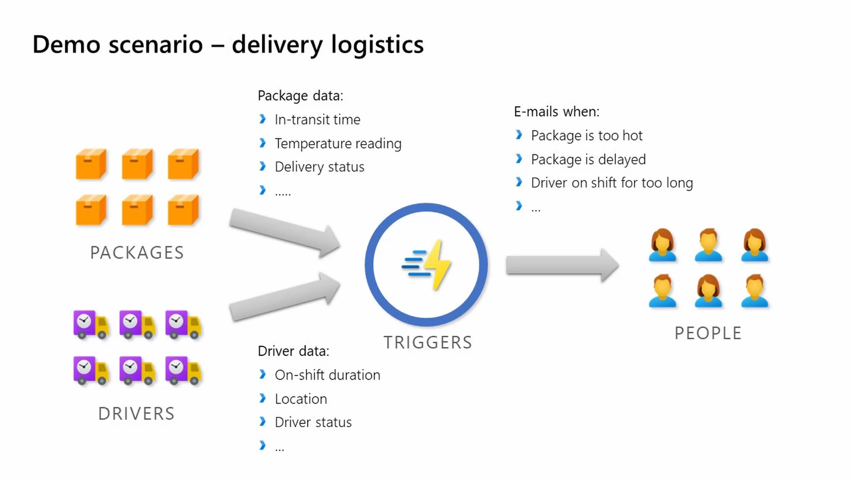
Notes:
Will T Reflex demo duration 3:15

